Slide 1
CSE 1102 Fundamentals of Programming Lecture #1
Spring 2017
Computer Science & Engineering Program
School of Electrical Engineering & Computing
Adama Science & Technology University

Slide 2
Problem Solving and Computer Programming
Problem solving life cycle
Basics of programming language
Case study: Heat Transfer
Guess a Number Game
Reading assignment
Chapter 1 of the textbook
Read about
Computer Storage
How a computer runs programs?
Pseudo Code and Flowchart
-Heat Transfer Notes
http://www.freestudy.co.uk/heat%20transfer/

Slide 3
Outline
Problem Solving Life Cycle
Phase 1: Development
Phase 2: Documentation
Phase 3: Maintenance
Basics of Programming Language
Programming Languages
Low level and High level languages
Compiled vs. Interpreted
Procedural and Object Oriented
Compilation in C++
General Notes on C++

Slide 4
Software Development
Computer Program
Self-contained set of instructions used to
instruct a computer to produce specific result
Problem Solving Life Cycle
Also called Software Development Procedure
Helps developers understand the problem
to be solved and create an effective, appropriate software solution

Slide 5
Problem Solving Life Cycle
Requirement
Phase 1: Development
Analysis
Design
Coding
Testing
Phase 2: Documentation
Phase 3: Maintenance

Slide 6
Requirement
Request for a program or statement of a problem
After a program requirement is received, phase 1 begins.
In the real world, it is a complex task of extracting and documenting user requirements

Slide 7
Phase 1: Development
Step 1: Analyze the Problem
Determine and understand the output items the program must produce
Determine the input items

Slide 8
Phase 1: Development
Step 2: Develop a Solution
Select the exact set of steps, called
an “algorithm”, to solve the problem
Refine the algorithm
Start with initial solution in the analysis step until you have an acceptable and complete solution
Check solution
***Read about Pseudo Code & Flowchart

Slide 9
Phase 1: Development
Step 3: Code the Solution
Consists of actually writing a C++ program that corresponds to the solution developed in Step 2
Program should contain well-defined patterns or structures of the following types:
Sequence
Selection
Iteration
Invocation

Slide 10
Phase 1: Development
Step 3: Code the Solution
Sequence: Defines the order in which instructions are executed
Selection: Allows a choice between different operations, based on some condition
Iteration: Allows the same operation to be repeated based on some condition
Also called looping or repetition
Invocation: Involves invoking a set of statements when needed

Slide 11
Phase 1: Development
Step 4: Test and Correct the Program
Testing: Method to verify correctness and that requirements are met
Bug : A program error
Debugging : The process of locating an error, and correcting and verifying the correction
Testing may reveal errors, but does not guarantee the absence of errors

Slide 12
Phase II: Documentation
Five main documents are needed:
Program description
Algorithm development and changes
Well-commented program listing
Sample test runs
Users' manual

Slide 13
Phase III: Maintenance
Ongoing correction of newly discovered bugs
Revisions to meet changing user needs
Addition of new features
Usually the longest phase
Good documentation vital for effective maintenance

Slide 14
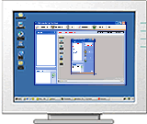
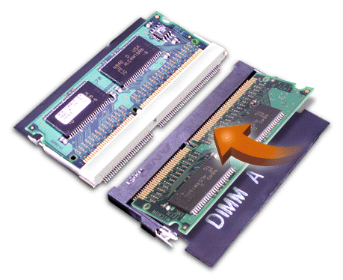
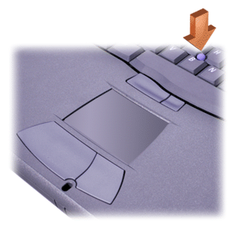
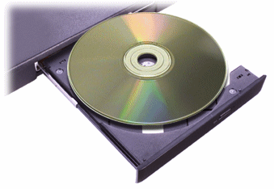
Computer Hardware
Computer hardware: Components that support the capabilities of the computer
ALU
CU
CPU
Input Devices
Main Memory
Output Devices
Secondary Memory
14

Slide 15
Computer Software
Application software: Programs written to perform particular tasks for users
System software: Collection of programs to operate the computer system

Slide 16
Computer Software
Operating system: The set of system programs used to operate and control a computer
Tasks performed by the OS include:
Memory management
Allocation of CPU time
Control of input and output
Management of secondary storage devices
Notes:
Memory management is the process of controlling and coordinating computer memory, assigning portions called blocks to various running programs to optimize overall system performance. Memory management resides in hardware, in the OS (operating system), and in programs and applications.
CPU time (or process time) is the amount of time for which a central processing unit (CPU) was used for processing instructions of a computer program or operating system, as opposed to, for example, waiting for input/output (I/O) operations or entering low-power (idle) mode.
In computer science, run time, runtime or execution time is the time during which a program is running (executing), in contrast to other program lifecycle phases such as compile time, link time and load time.
What is input and output in management?
The term I/O is used to describe any program, operation or device that transfers data to or from a computer and to or from a peripheral device. Every transfer is an output from one device and an input into another.

Slide 17
A Layered View of the Computer
Application Programs Word-Processors, Spreadsheets, Database Software, IDEs
System Software Compilers, Interpreters, Preprocessors Operating System, Device Drivers
Computer Hardware

Slide 18
Programming Languages
Programming: Process of writing a program, or software
Programming language
Set of instructions used to construct a program
Comes in a variety of forms and types

Slide 19
Low and High Level Languages
Low-level languages: Languages that use instructions tied directly to one type of computer
machine language, assembly language
High-level languages: Instructions resemble written languages, such as English
Can be run on a variety of computer types
Visual Basic, C, C++, Java

Slide 20
Low and High Level Languages

Slide 21
Machine Language
Machine language programs : only programs that can actually be used to operate a computer
Also referred to as object codes
Consists of a sequence of instructions composed of binary numbers
Contains two parts: an instruction and an address
Operation | Address
0010 | 0000 0000 0100
0100 | 0000 0000 0101
0011 | 0000 0000 0110

Slide 22
Assembly Language
Assembly language programs: Substitute word-like symbols, such as ADD, SUB, and MUL, for binary opcodes
Use decimal numbers and labels for memory addresses
One-to-one correspondence
Usually, each line of assembly code produces one machine instruction
Example: ADD 1, 2
Assemblers: Translate programs into machine language

Slide 23
High Level Language
One-to-many correspondence
Each statement corresponds to several machine language instructions
Much easier to program than in assembly language.
Data are referenced using descriptive names
Operations can be described using familiar symbols
Example:
cost = price + tax

Slide 24
Compiled vs. Interpreted
Interpreted: Each statement is translated individually and executed immediately after translation
Compiled: All statements are translated and stored as an executable program, or object program; execution occurs later
C++ is predominantly a compiled language

Slide 25
Source Code
The programs written in a high or low-level language
It is written by the programmer.
Can be compiled automatically into object code or machine code or executed by an interpreter.
C++ source programs have extension ‘.cpp’ or ‘.h’

Slide 26
Compiler
Translates high-level language to machine language.
Input to a compiler is the source code
Output from the compiler is the object code (.obj).
while (num != -1) {
sum += num;
count++;
cin >> num;
}
00001111
00110011 11111111
00000000
11100111
Compiler
Source File .cpp
Object File .obj

Slide 27
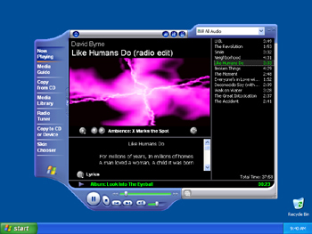
Linker
Combines your object code with pre-compiled object libraries for input/output etc.
Input are the object files (.obj).
Output is the executable file (.exe) in Windows.
00001111
00110011 11111111
00000000
11100111
00001111
00110011 11111111
00000000
11100111
Linker
Object File .obj
Executable File .exe
Library Files .obj

Slide 28
Compilation Process in C++
C++ actually adds an extra step to the compilation process
the code is run through a preprocessor, which applies some modifications to the source code, before being fed to the compiler.
Eg. Removing comment

Slide 29
Program in Memory
The purpose of most application programs is to process data to produce specific results

Slide 30
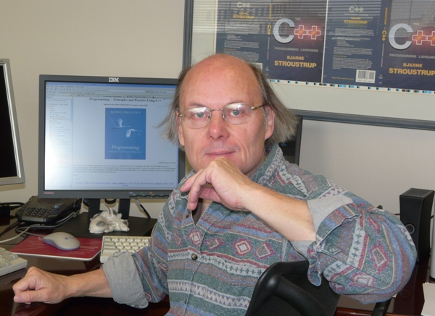
General Notes on C++
C++ is immensely popular
particularly for applications that require speed and/or access to some low-level features.
It was created in 1979 by Bjarne Stroustrup
at first as a set of extensions
to the C programming language.

Slide 31
General Notes on C++
You can write graphical programs in C++
it is much harder and less portable than text based(console)programs.
We will be sticking to console programs in this course.
Everything in C++ is case sensitive:
someName is not the same as SomeName.

Slide 32
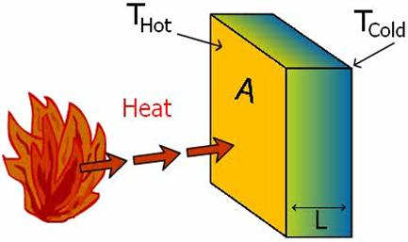
Case Study: Heat Transfer
The following formula is used to determine the heat transferred through a flat substance, such as a wall, with its two sides maintained at different temperatures:
$$q=−k\left(\frac{T_{2}−T_{1}}{d}\right)$$

Slide 33
Case Study: Heat Transfer
q is the heat transfer.
k is the thermal conductivity of the substance in watts/m°C.
T₂ is the higher temperature on one side of the substance in °C.
T₁ is the lower temperature on the other side of the wall in °C.
d is the thickness of the substance in meters.

Slide 34
Case Study: Heat Transfer
Determine the units of q
by calculating the units resulting from the right side of the formula.
A glass window
thickness of 0.5 centimeters,
thermal conductivity of 0.77 watts/m°C, and
outside and inside temperatures of 36.6°C & 22.2°,
Determine the value of q.

Slide 35
Case Study: Heat Transfer
If you were asked to write a computer program to determine the heat transfer through a substance, what inputs, outputs, and algorithm would your program require?

Slide 36
Case Study: Guess a Number Game
Step 1: Analyze the Problem
The objective is to randomly generate an integer greater than or equal to 0 and less than 100. Then prompt the player (user) to guess the number.
Input: Guessed Number
Output: Guess is Correct or Guess is Higher, or Guess is Lower

Slide 37
Case Study: Guess a Number Game
Step 2: Develop a Solution
Accept guessed number from user
If the player guesses the number correctly, output an appropriate message.
If the guessed number is less than the random number generated
display ‘‘guess is lower than the number. Guess again!’’;
4. Otherwise
display ‘‘guess is higher than the number. Guess again!’’;

Slide 38
Case Study: Guess a Number Game
Step 3: Then prompt the player to enter another number.
Step 4: The player is prompted to guess the random number until the player enters the correct number and stop after fixed no of trials .

